Slide 1
Team A
Project 6X6 Tic Tac Toe Game
By Ibra, Eddie, Jason, Carrie, Alexis, Alfonso
Notes:
1
1

Slide 2
Role of each member
Jason Jensen: | Team lead and architect of the AI.
Eddie Aguilar: | Sub team lead and architect of the single player mode (PvP).
Alfonso Euclides: | Tester and secretary
Carrie Dumit: | Secretary and Tester.
Ibra : | Developer and architect of the GUI interface.
Alexis Franciosi: | Secretary.
Notes:
2
2

Slide 3
Introduction
Tic-Tac-Toe is a two-player game, played on a 3x3 square, where the winner is the first player to connect three in a row.
For this project we will be developing an enhanced version of the game utilizing a 6x6 square and in which the winner is the player with the most 4 in a row squares once the entire board is filled.
In conclusion it will be 6X6X4 version of the classic Tic Tac Toe game.
Notes:
3
3

Slide 4
Application Domain
Environment for software to operate - Windows, and Linux.
Game should be played offline and accessible to the public.
Player can play as guest or a registered user.
Game should allow players to view their history.
Game should keep track of players turns and display player user names.
Games should be not have a downtime.
Notes:
4
4

Slide 5
Project approach
Notes:
5
5

Slide 6
Non Functional Requirements
According to our client, the requirements are as follow:
Users should be able to play the game offline.
User should be able to see their current score.
Users should be able to sign up.
Users should be able to play as guest.
Users should be able to reset their password.
Notes:
6
6

Slide 7
Non-Functional
Requirements Continued
-Cost Constraints:
No monetary cost constraints.
Team effort & time constraints.
Set reasonable deadlines.
Manage time effectively.
-Risks:
Possible loss of member team.
Getting the architecture incorrect.
-Reliability:
Games should not have downtime.
Notes:
7
7

Slide 8
Cost Constraints Description
There is no budgetary requirements for this project since it is a school/academic project.
We can, however, measure time spent, quality of work, effort applied, etc.
None of our developers will be paid therefore, enjoy the free game
Notes:
8
8

Slide 9
Risks Descriptions
Our quality of assurance is to deliver the product on time.
In case this is not possible, we will release the beta version with minor bugs and publish an updated version after the deadline
The risk for this is to have a low grade which we are not intending to do so
Notes:
9
9

Slide 10
Reliability Specifications
We assure that our team is reliable and can deliver the project on time.
This is proven by our expected dates and phases chosen to accomplishment milestones.
There are a total of 16 weeks which we took as 4 weeks for doing requirement, analysis, and design.
Week 5, we will do implementation and test on each sub-stone.
By week 12, we will have it nearly completed and use week 13-16 for debugging and finalizing.
Notes:
10
10

Slide 11
Requirements and Object Oriented Analysis 2/23 | Preliminary Software Project Management Present risks and constrains Specify Configuration Control Present preliminary use cases
Complete all first phases and present first prototype 3/31 | Complete Requirements and Product Specifications Present first prototype Complete management plan
Present Demo and Source Code 4/26 | Complete Details on Design Test completed plan
Competition 4/28 | Test for reusability and portability Team members evaluation
Notes:
11

Slide 12
Functional Requirements
The functional requirements will be determined through multiple use cases:
Register a player
Login as an existing player or a guest
Player vs Player (PvP)
Single player vs AI
Choose level of difficulty
Choose game piece (X is blue or O is red)
Notes:
12
12

Slide 13
Functional Requirements Use Cases
Case 1: Register new account | Set up username and password for new user to log into the game.
Case 2: Login as existing user. | Enter the username and password to log into the game.
Case 3: Play as guest. | Start a new game without logging in.
Case 4: Reset Password. | User resets account password.
Case 5: Display player statistics. | Displays user Win/Loss record.
Notes:
13
13

Slide 14
Use Cases Continuation
Case 6: Player vs. player | User selects game mode to play against another player.
Case 7: Player vs. AI | Choose to play the game against another player or against the AI.
Case 8: Difficulty level. | Adjust the AI difficulty level.
Case 9: Select stone color. | Choose the color for the two players.
Case 10: Select first player. | Choose which color will go first.
Notes:
14
14

Slide 15
Use Cases Continuation
Case 11: Exit | Exists the current window and goes to previous one.
Case 12: Logout | Log user out so another user can log in or to allow playing as guest.
Notes:
15
15

Slide 16
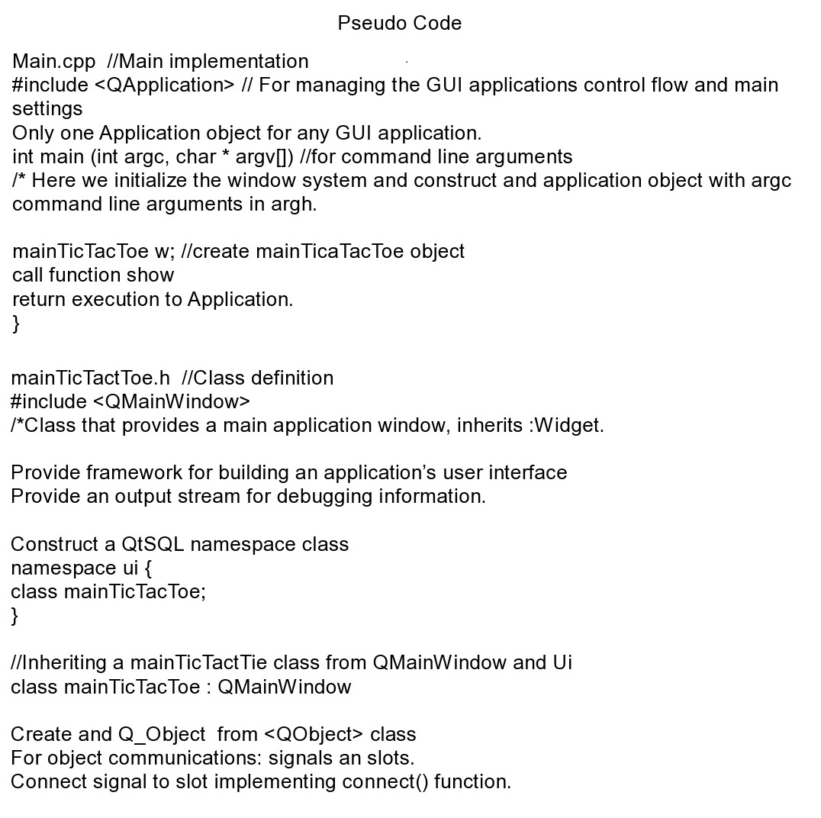
Notes:
16

Slide 17
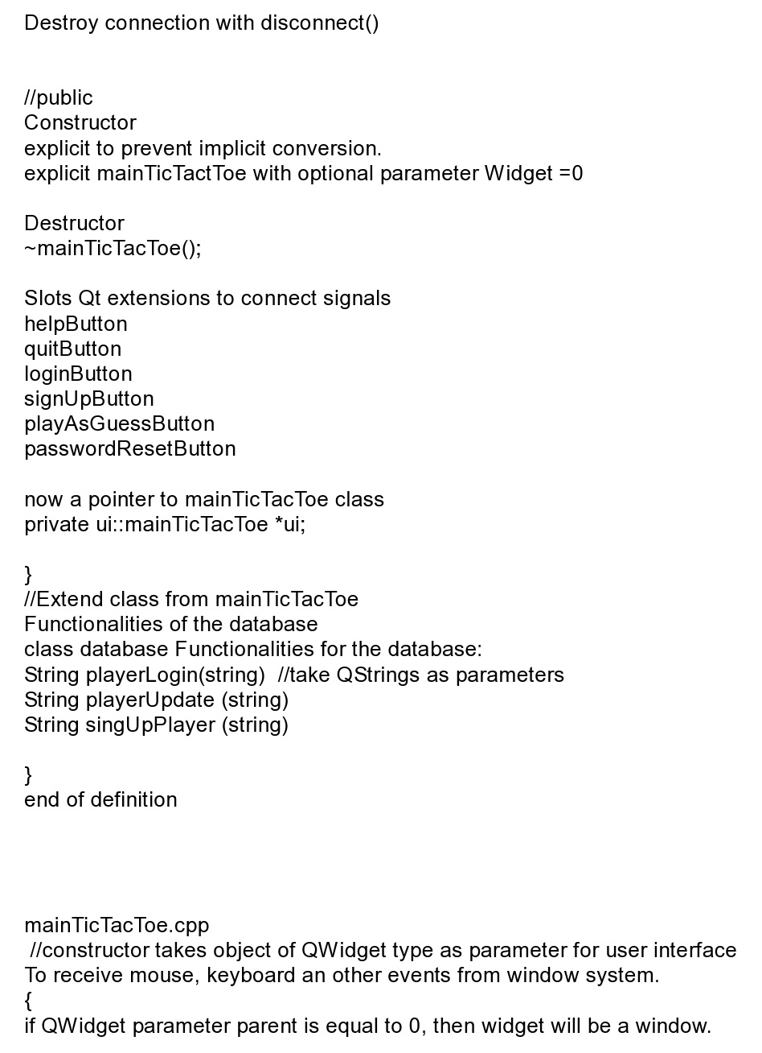
Notes:
17

Slide 18
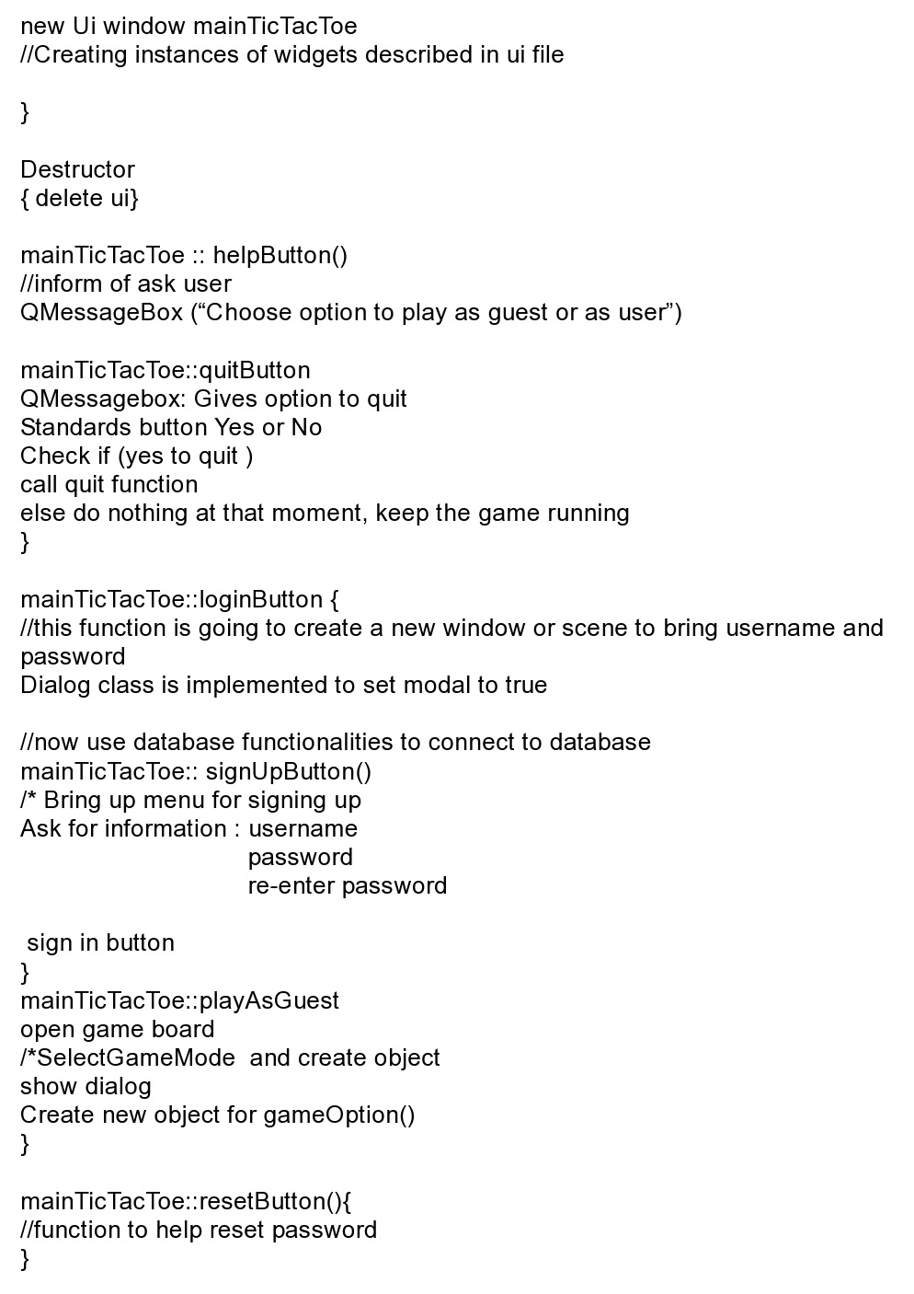
Notes:
18

Slide 19
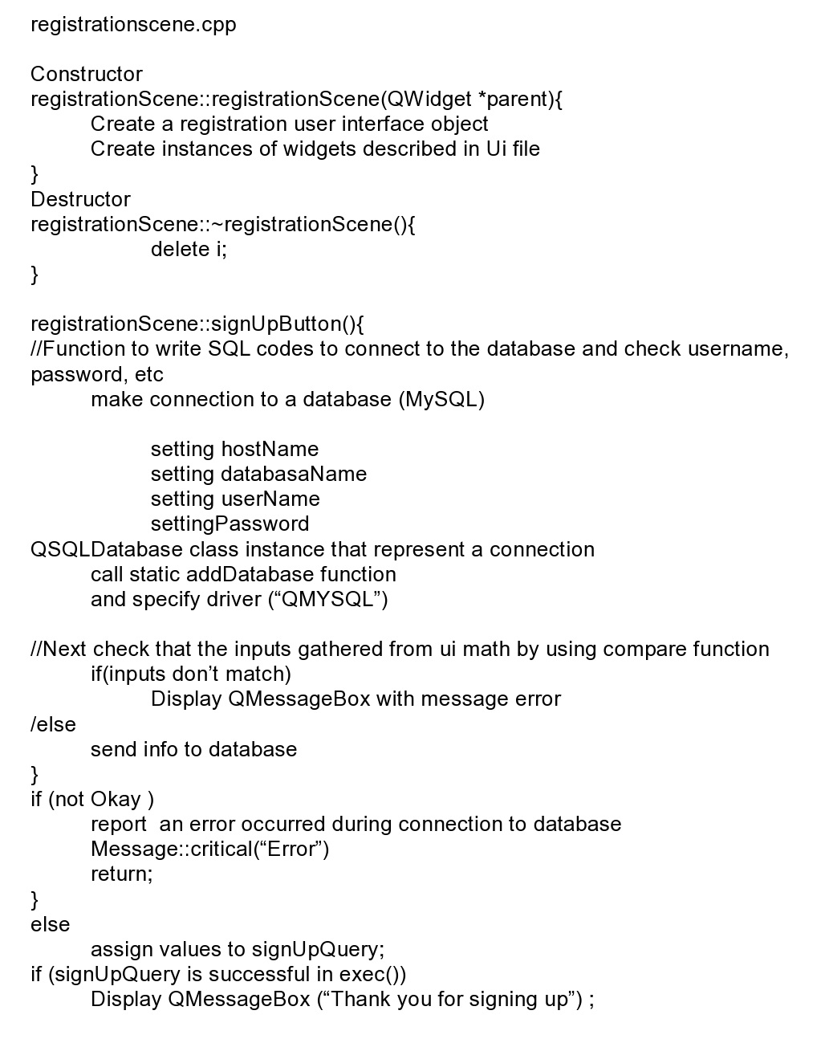
Notes:
19

Slide 20
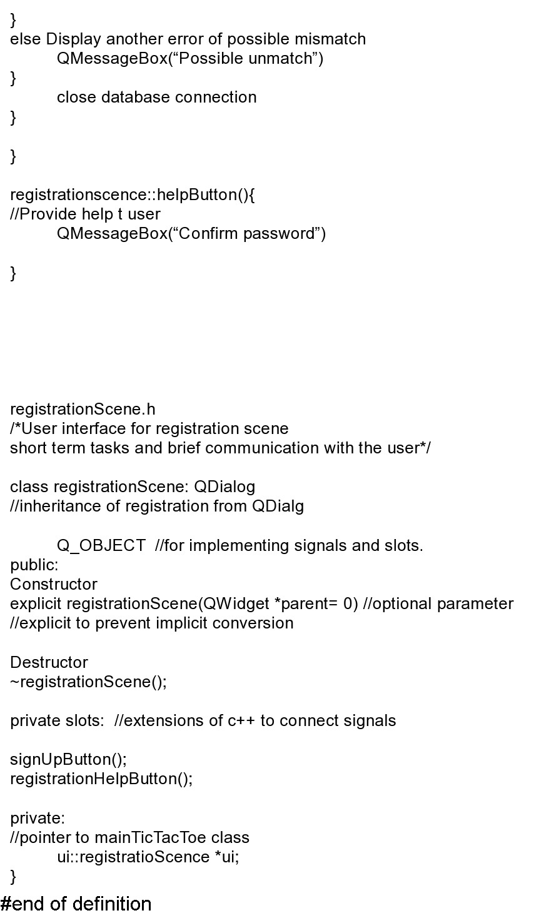
Notes:
20

Slide 21
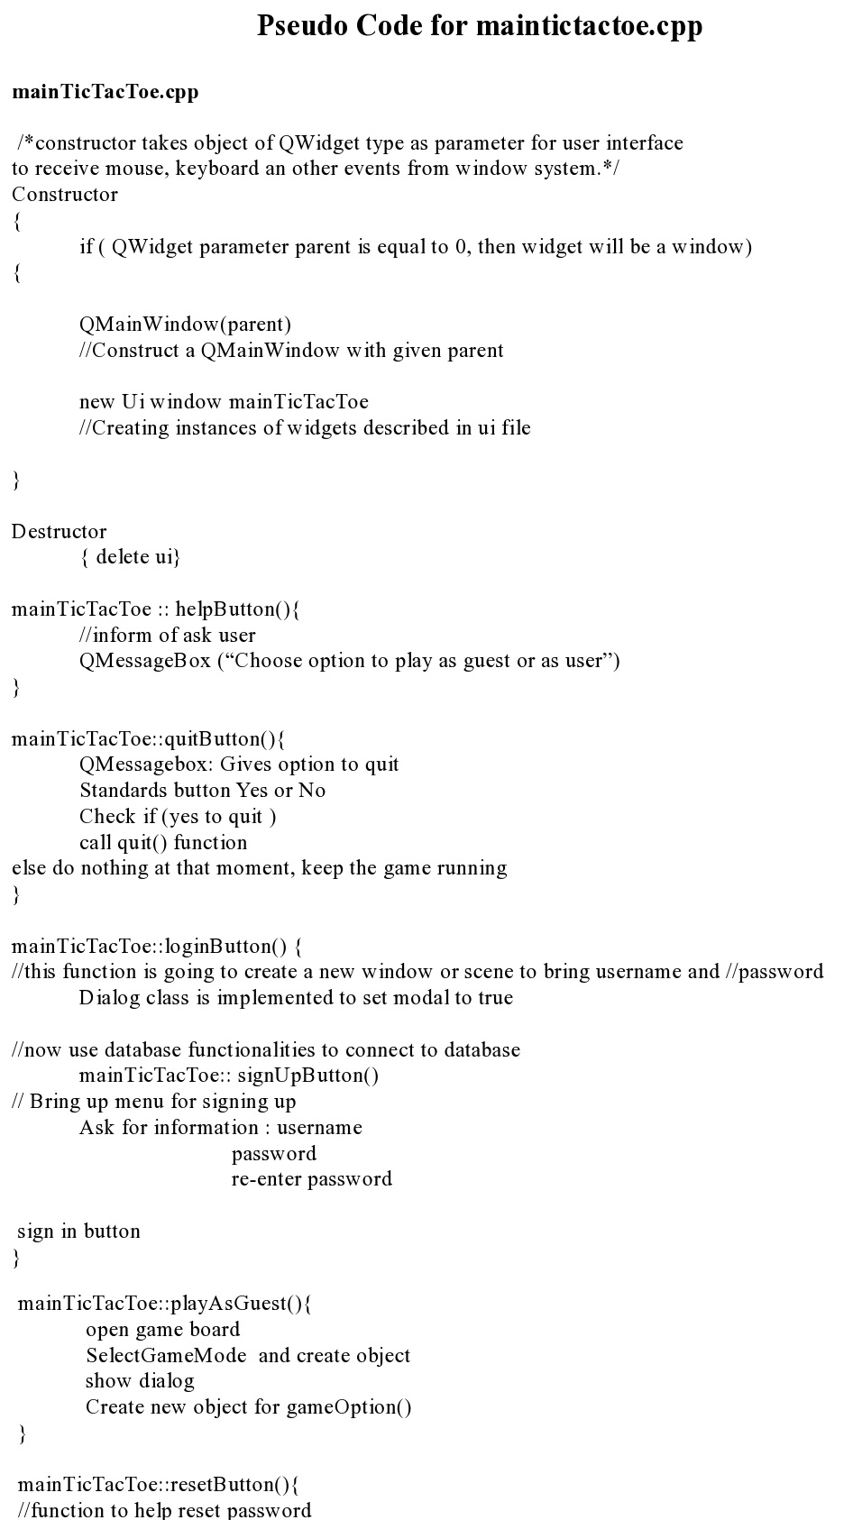
Notes:
21

Slide 22
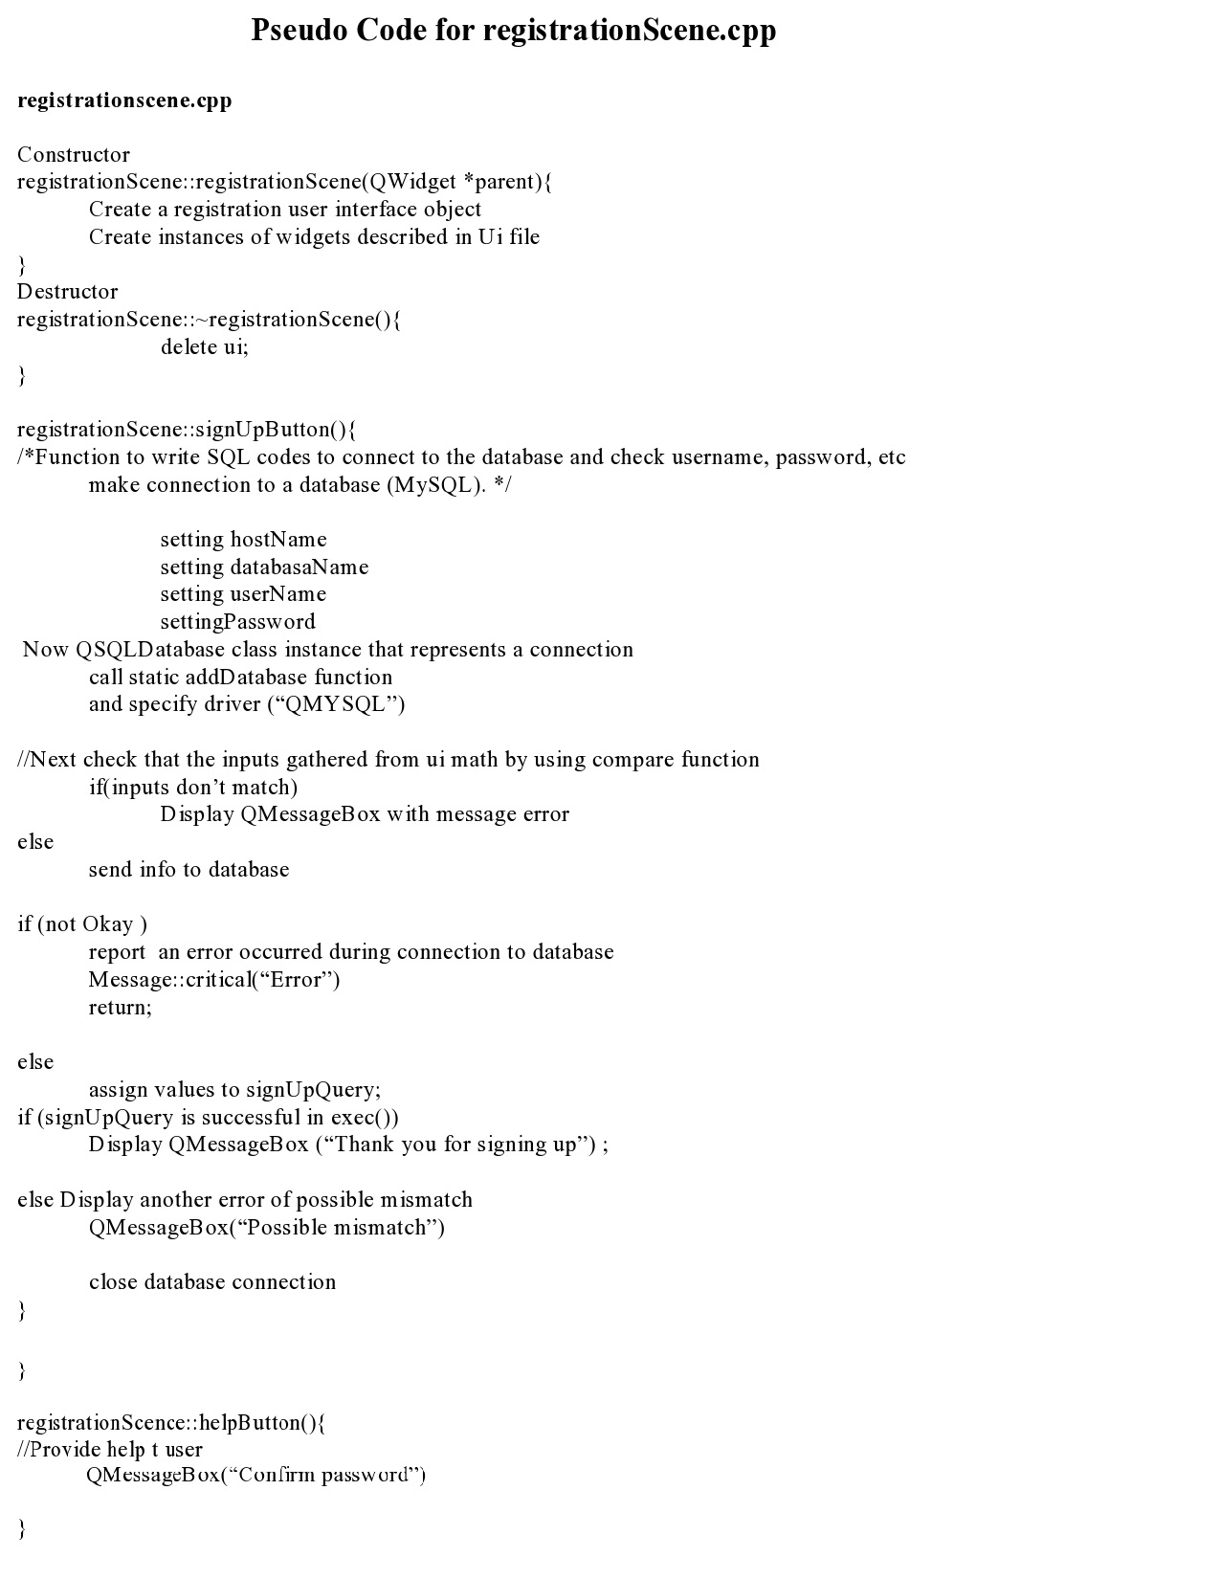
Notes:
22

Slide 23
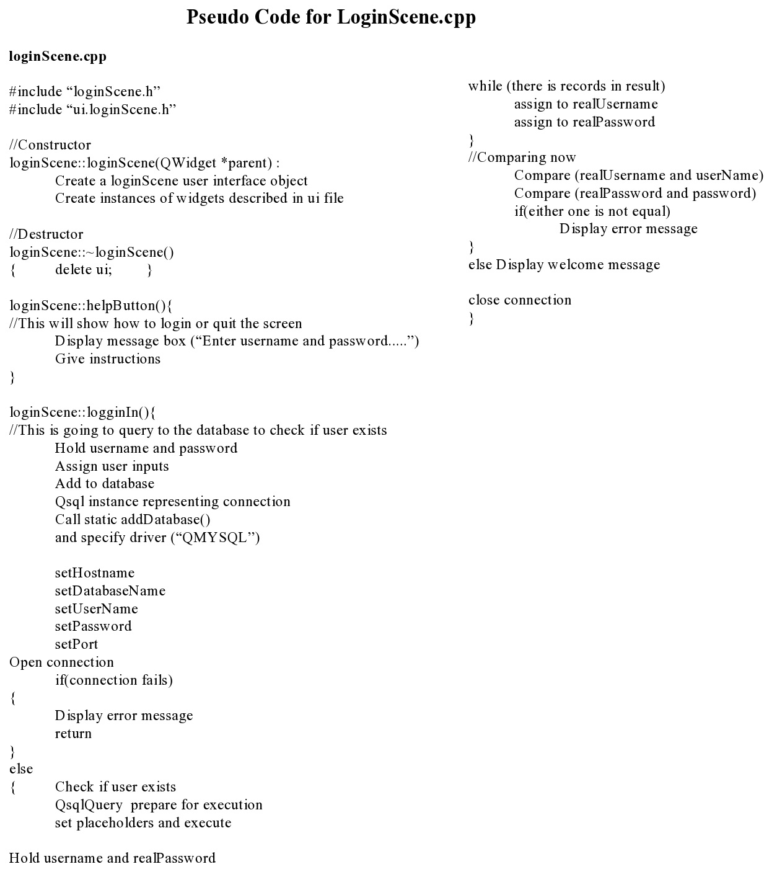
Notes:
23

Slide 24
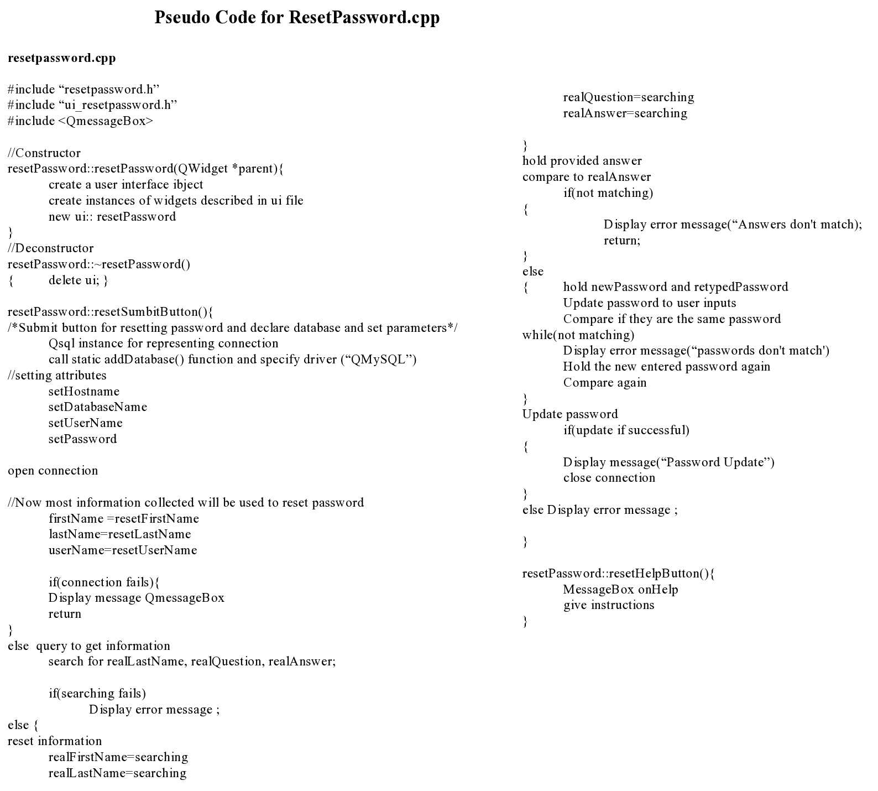
Notes:
24

Slide 25
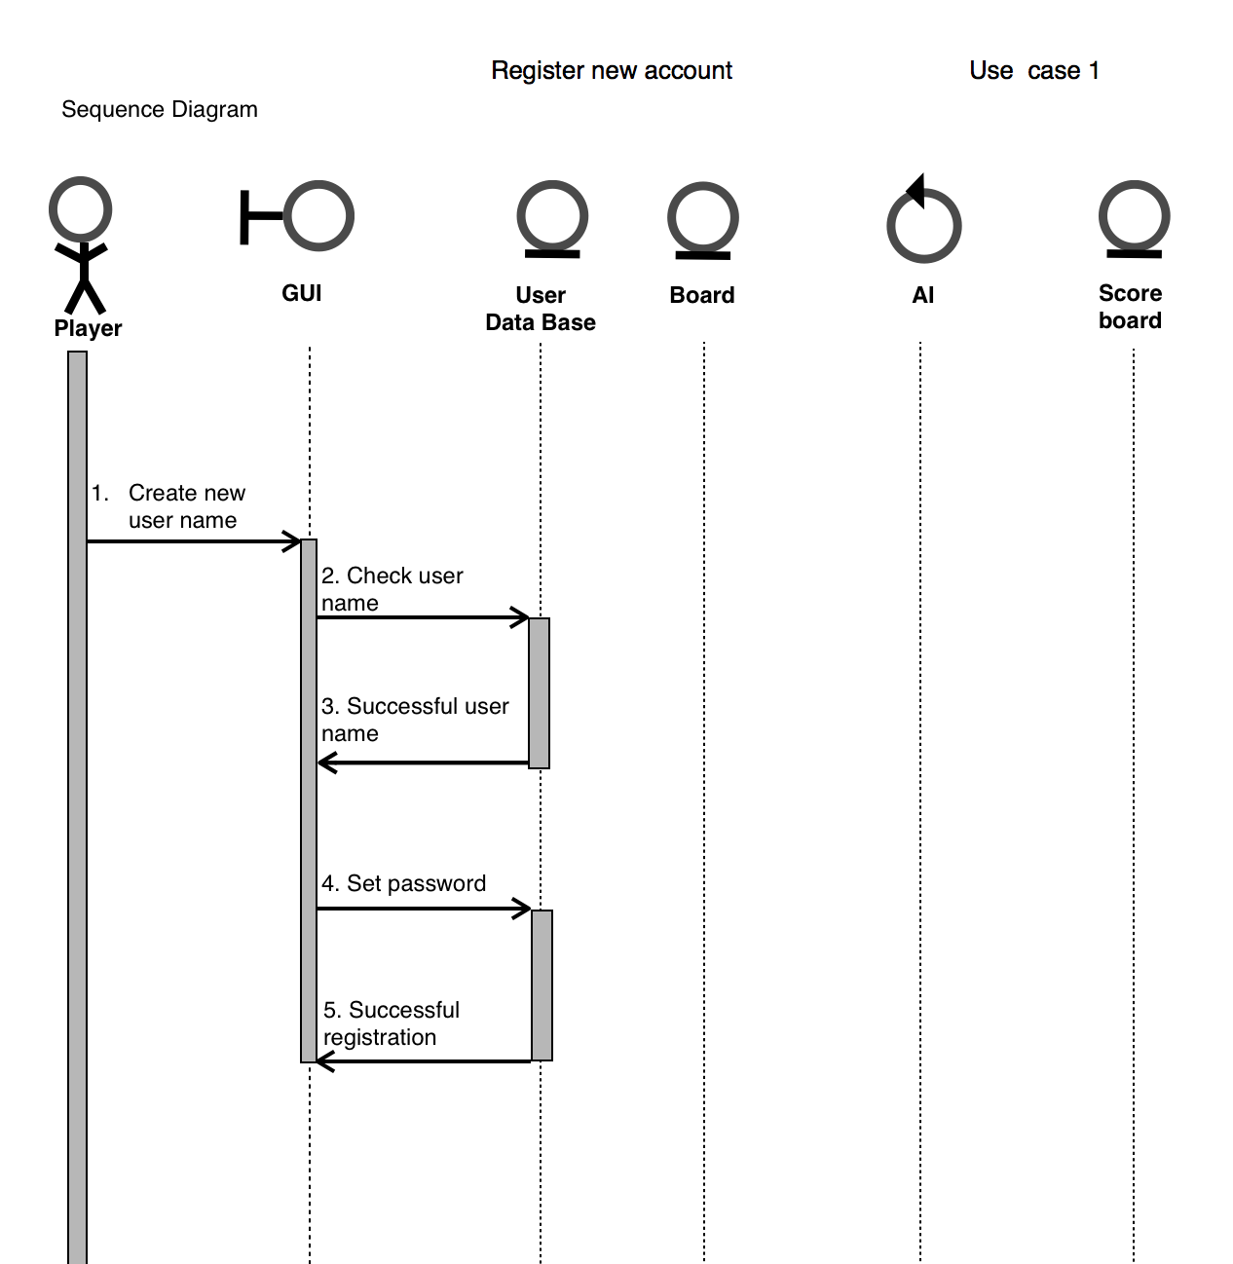
Regiter User Use Case
Notes:
25

Slide 26
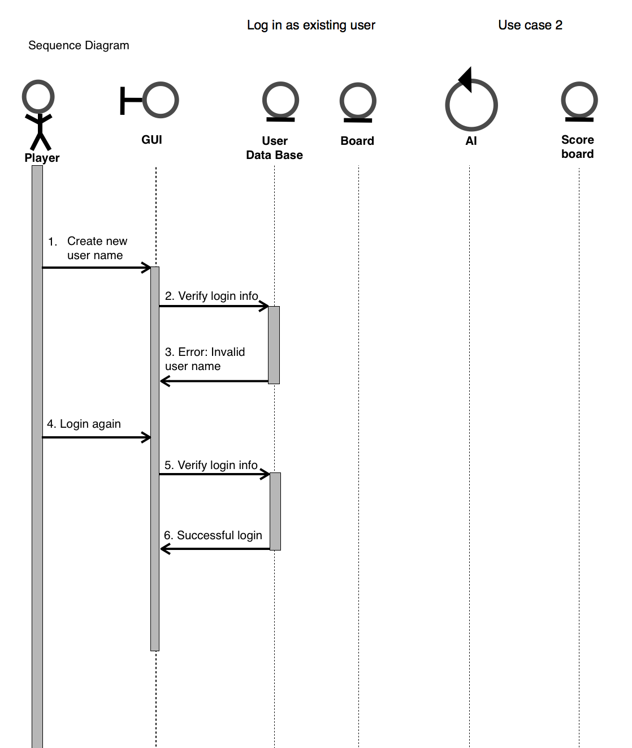
Notes:
26

Slide 27
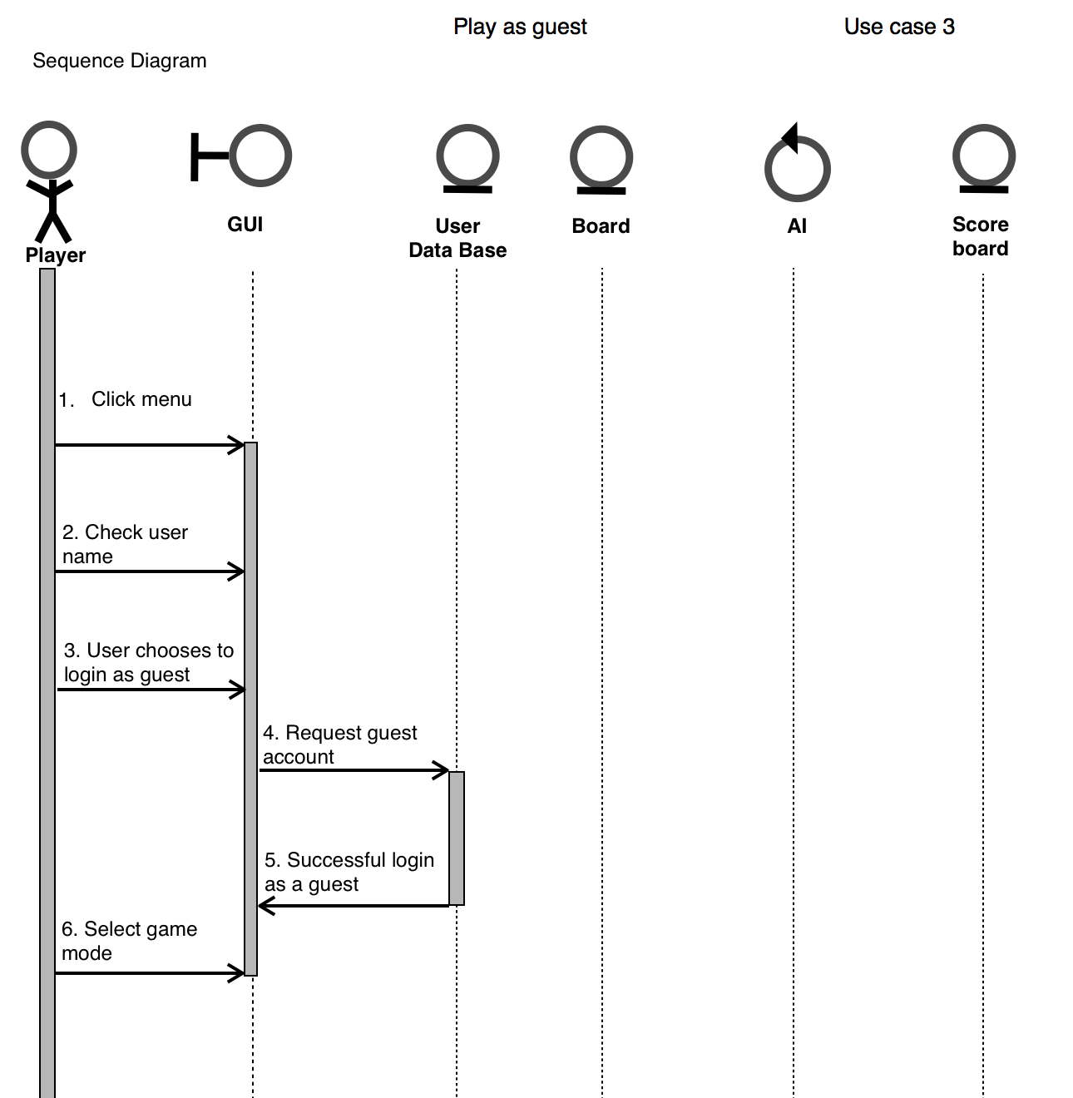
Notes:
27

Slide 28
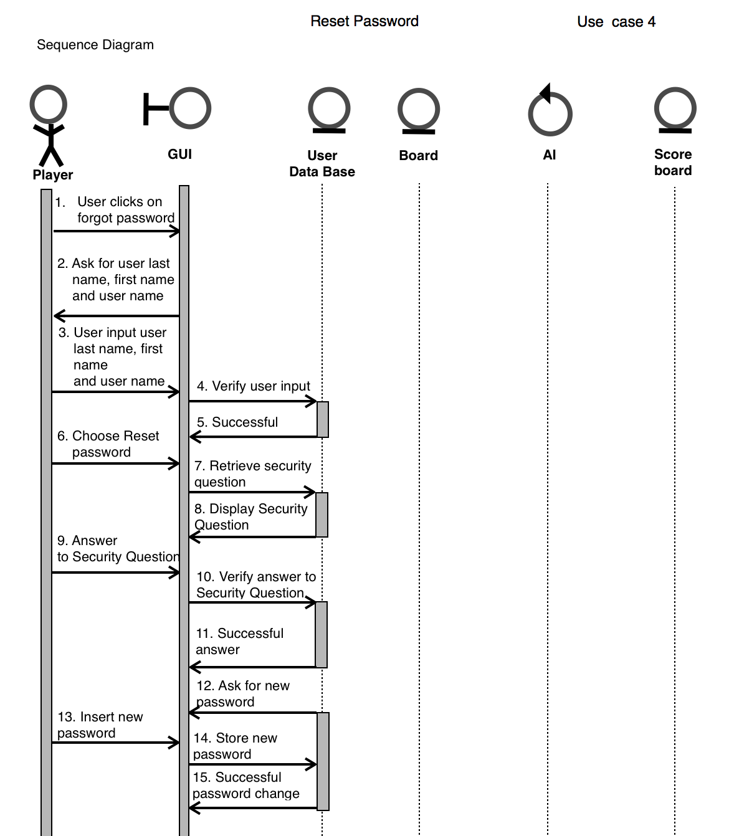
Notes:
28

Slide 29
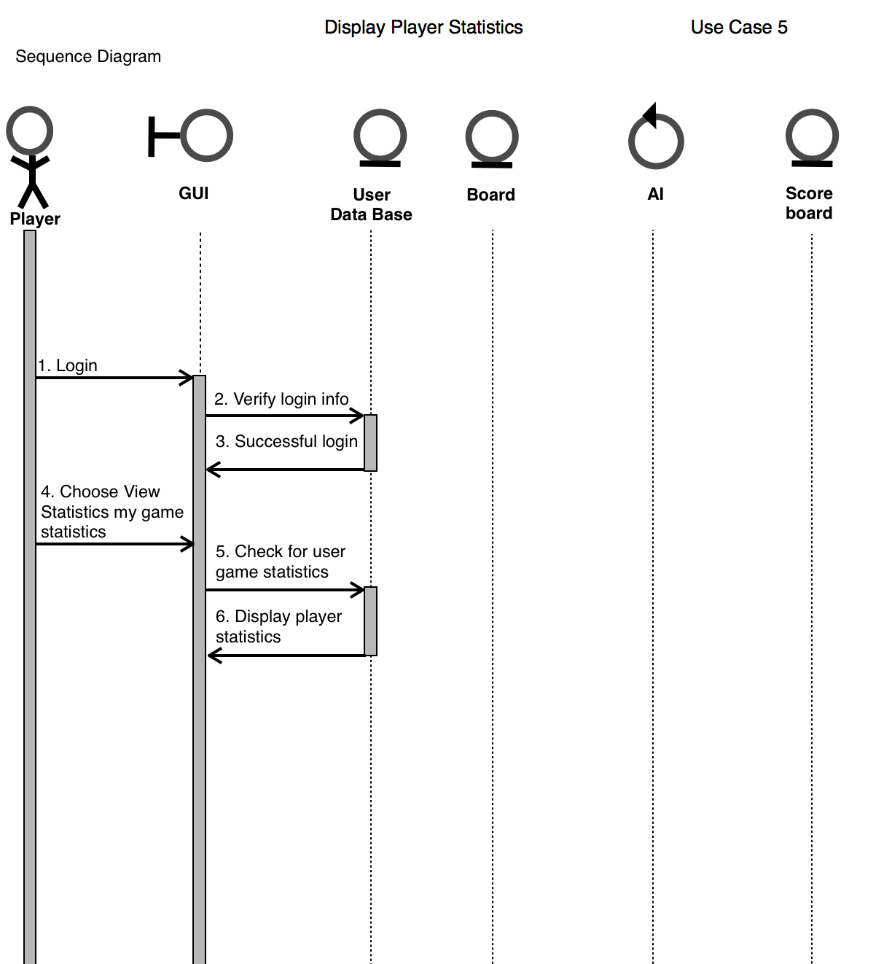
Notes:
29

Slide 30
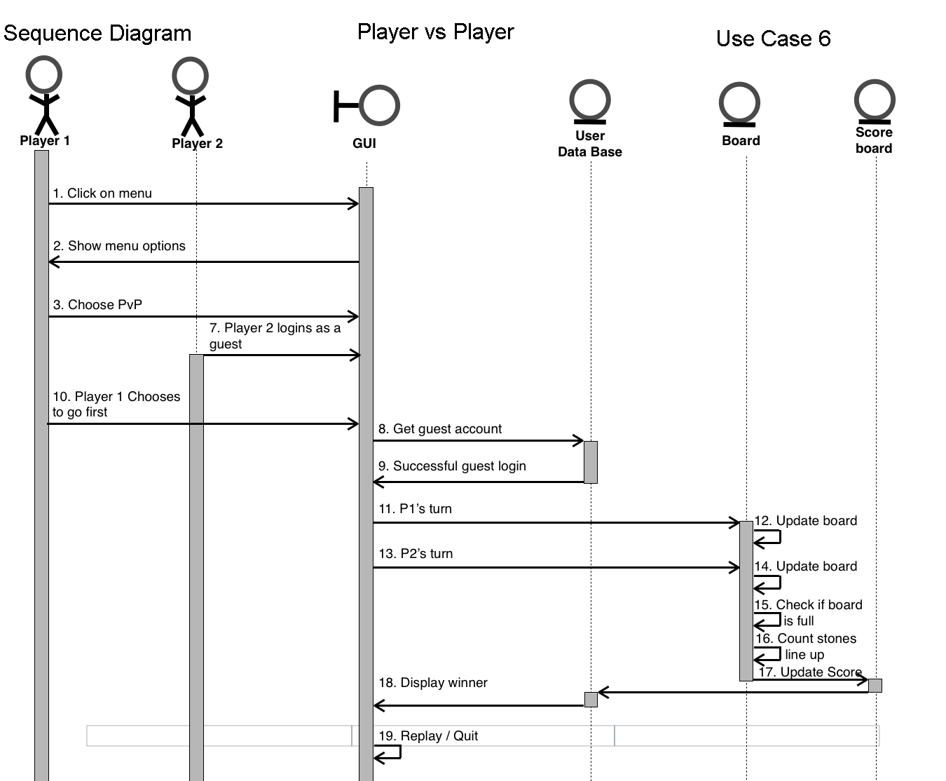
Notes:
30

Slide 31
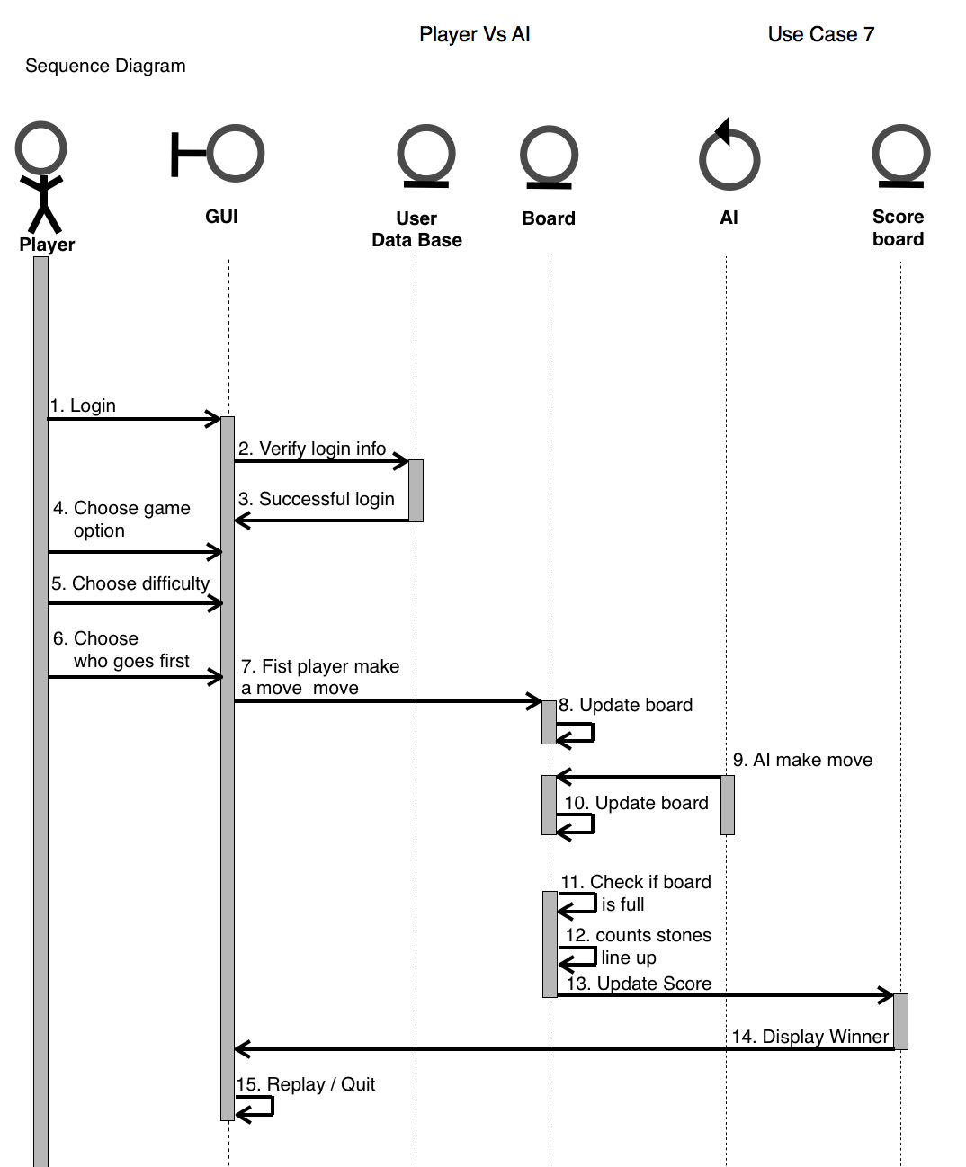
Notes:
31

Slide 32
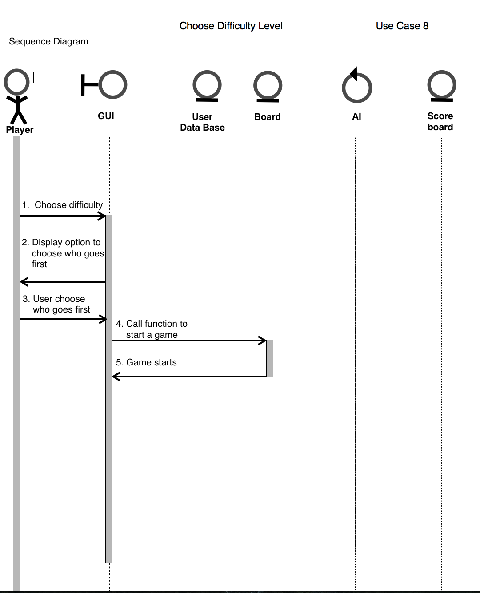
Notes:
32

Slide 33
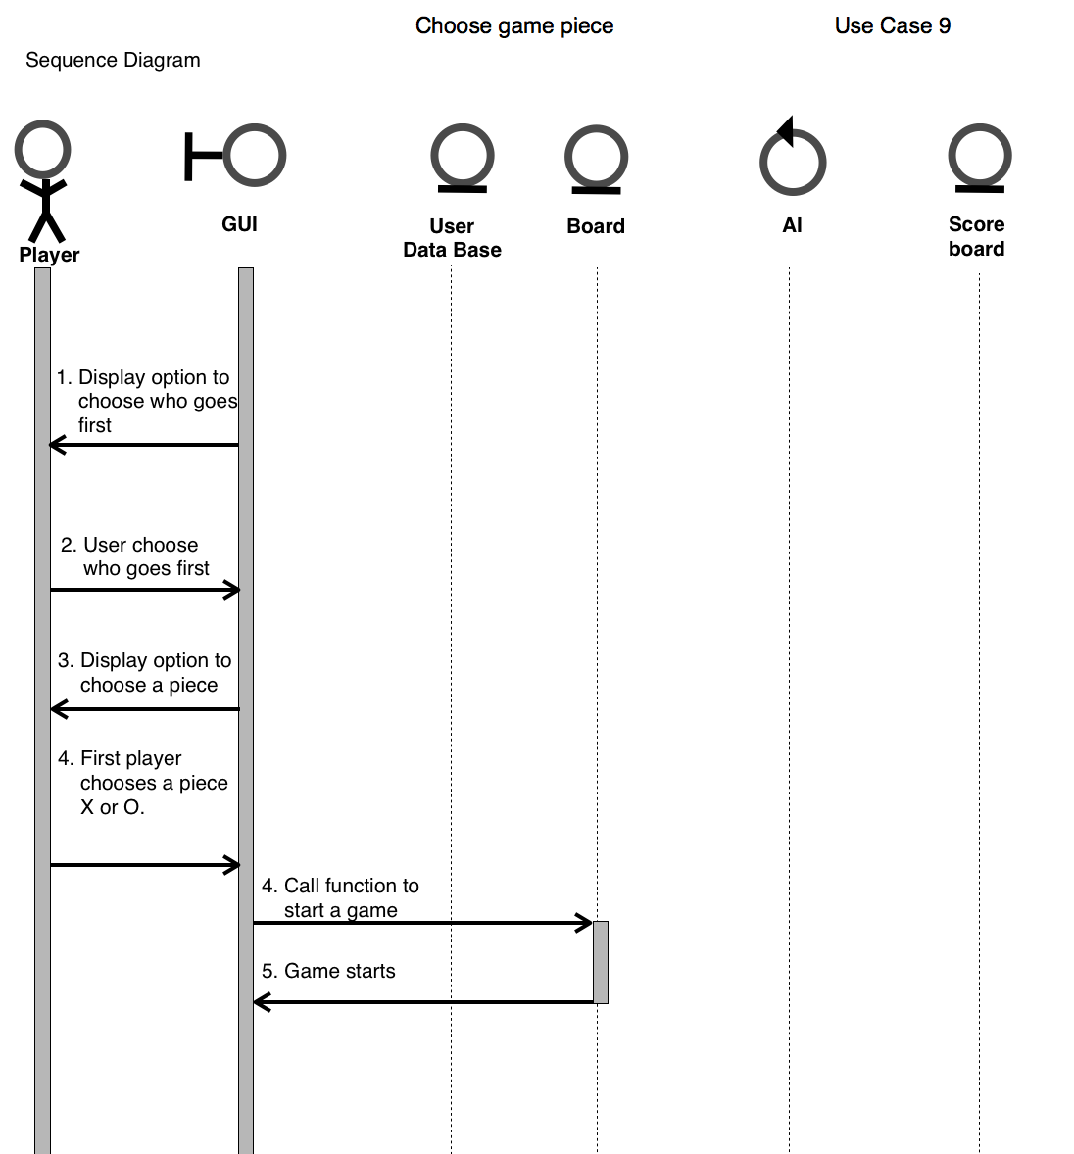
Notes:
33

Slide 34
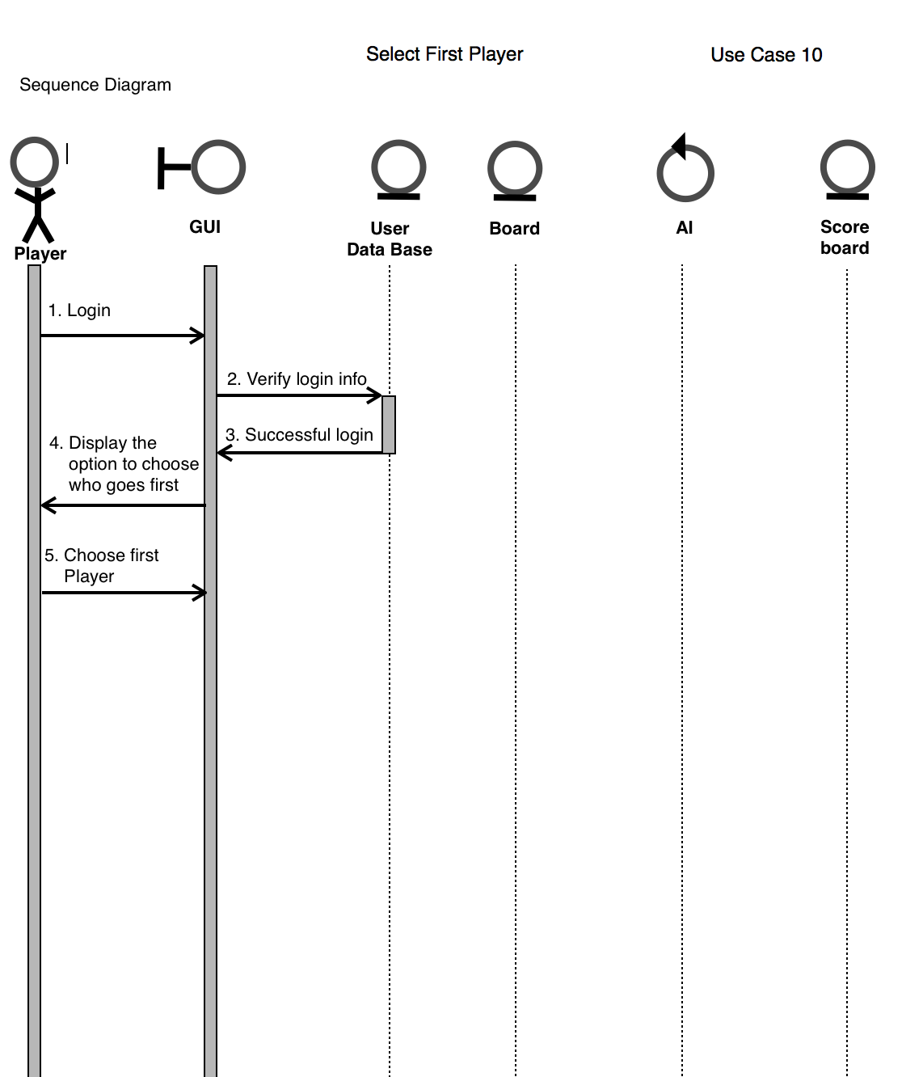
Notes:
34

Slide 35
Scenario Exceptions
Registering: If the user chooses an already taken username, it displays an error message.
Logging in: If the user does not enter the correct username or password, it displays an error message.
Play as Guest: If the user is already logged in and selects play as guest mode, it displays an error message.////Maybe have it confirm logout
Reset Password: If the user enters an incorrect username or answers the security question incorrectly, it displays an error.
View Statistics: If a new user requests to see history of plays, it notifies them that there is no saved plays.
Player vs. Player: If player two chooses to exit to change game play mode, we only accept input from player one, so it starts a new game and player two is now player one.
Notes:
35

Slide 36
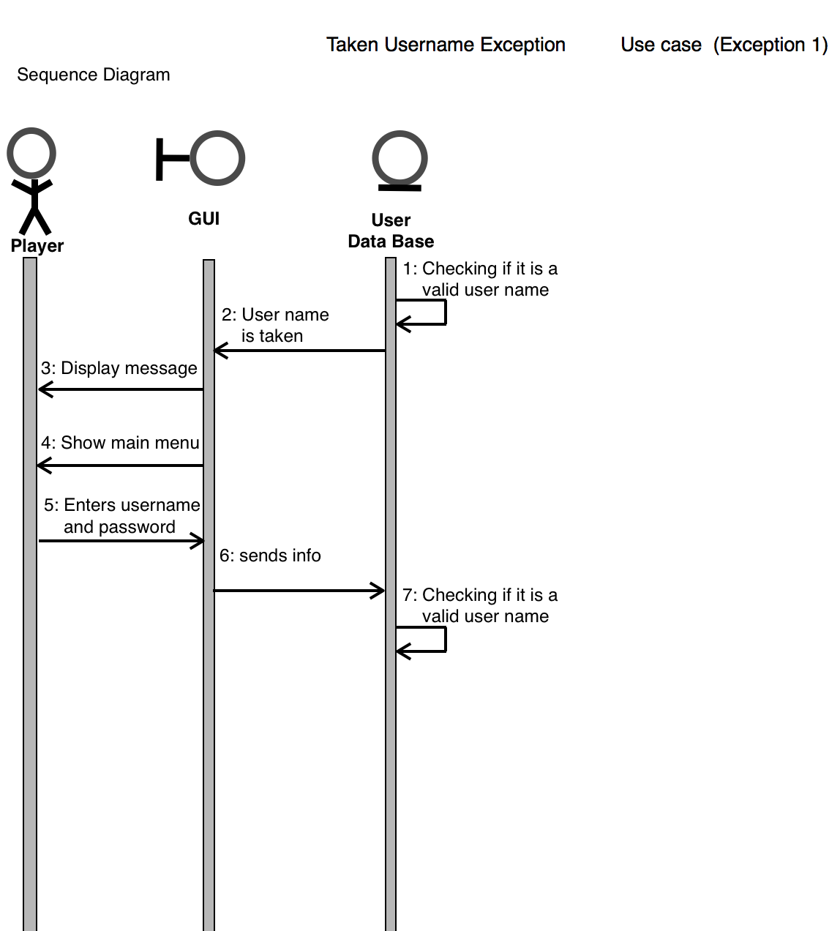

Slide 37
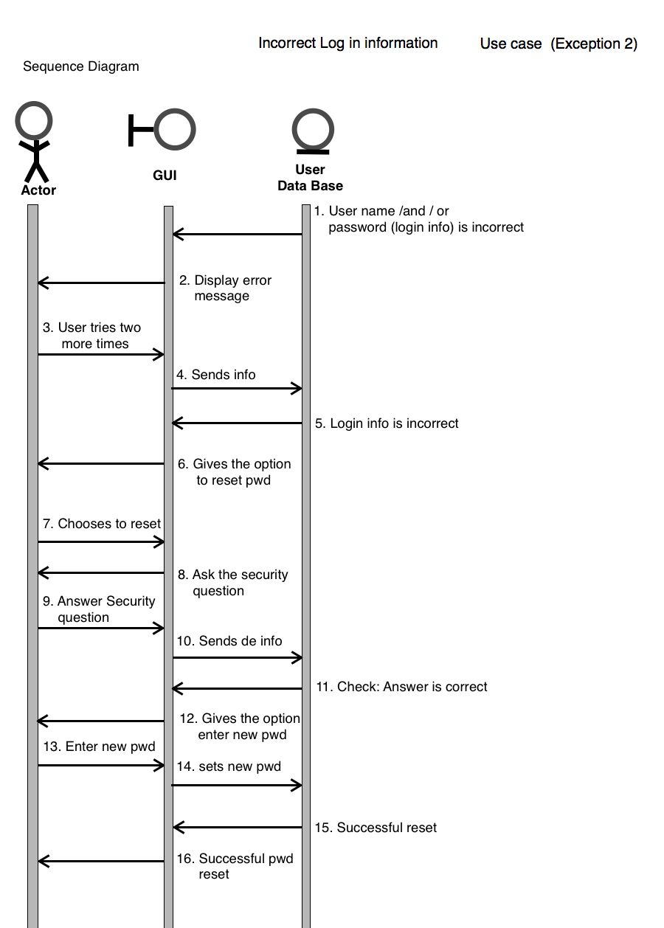

Slide 38
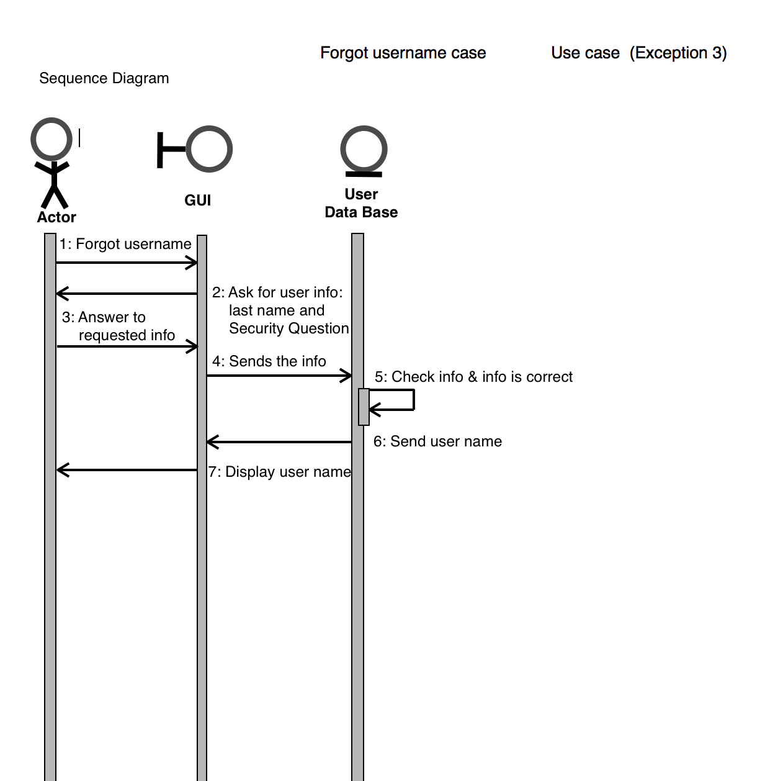

Slide 39
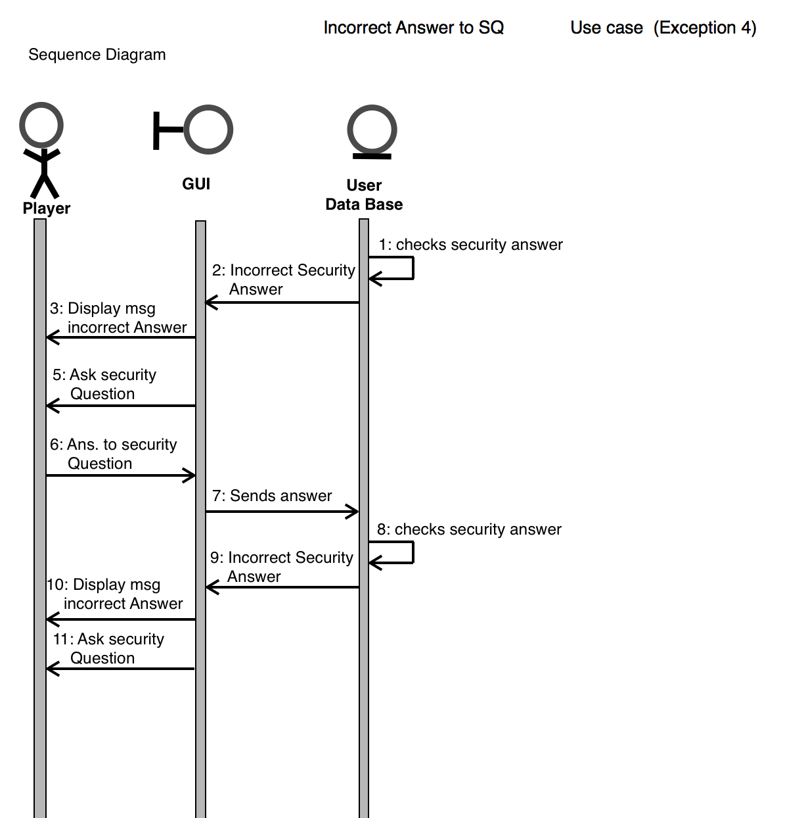

Slide 40
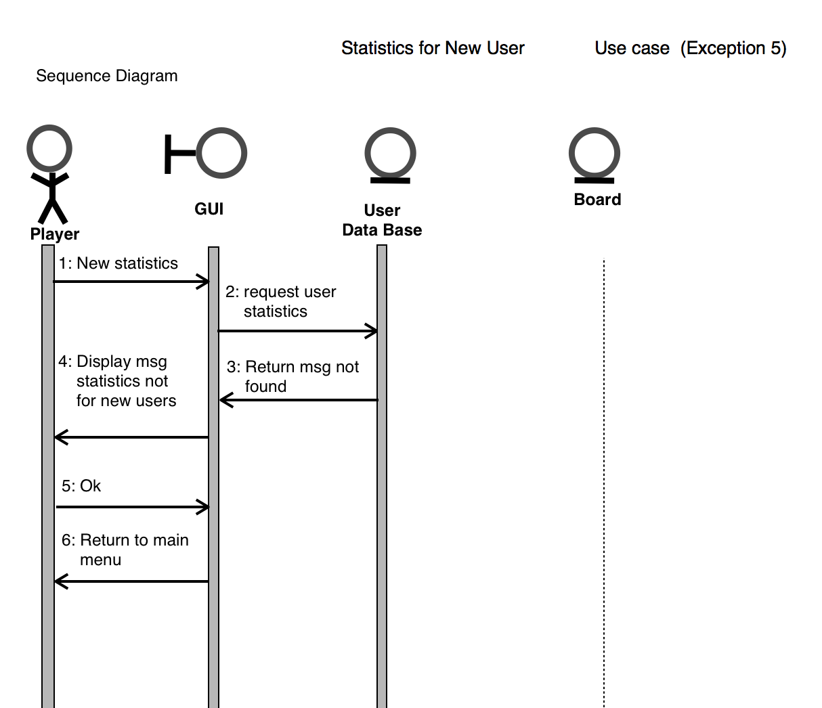

Slide 41
Integration Testing
Start game
Display score
Change modes
Choose difficulty level
Check if board is full
GUI easy to use
Notes:
41

Slide 42
Start Game Test
User is given the option to choose either X or O.
At this stage the option to go first is given as well.
Transitions form piece selection to start of game smoothly.
The chosen game piece is displayed correctly.
Notes:
42

Slide 43
Display Score Test
The user is able to see their current score.
The score is associated with the user name and displayed by order of play.
Notes:
43

Slide 44
Mode Change Test
The user is able to choose between Player Vs. Player and Player vs AI before starting game.
The user is also given the option to go back and change the play mode again if desired.
If the user decides to end the game on either of these two modes, it is counted as a loss.
Currently does not save game mode choice, once game ends user must choose the game mode again
Notes:
44

Slide 45
Difficulty Selection Test
User is able to choose between three levels of difficulty when playing Player vs AI.
These options remain disabled when playing Player Vs. Player
Each option will pass a unique value to the AI
Transition to game start is made.
Notes:
45

Slide 46
Full Board Test
After each turn, the score is updated and the game checks if the board is full
If the board is full the winner is determined by the highest listed score.
If the board is not full the turn begins.
Notes:
46

Slide 47
GUI Ease of Use Test
Alpha testers were able to adapt to the GUI easily.
A few modifications were made based on tester suggestions
Notes:
47

Slide 56
Notes:
56

